Slide 1


Integração Contínua
Muito Além do Build

Slide 2

Juan Lopes
Humano Level 21
@juanplopes
github.com/juanplopes

Slide 3


Slide 4


Slide 5
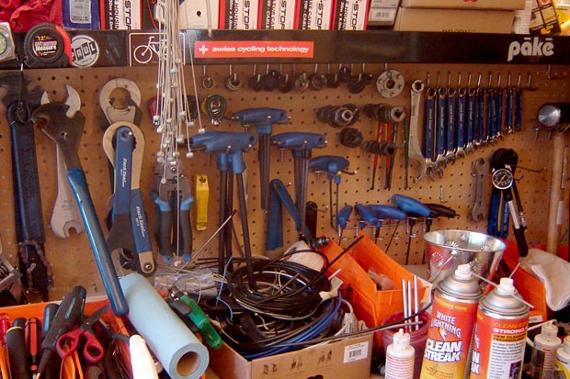
Muitas Ferramentas
Notes:
PERGUNTAR

Slide 6
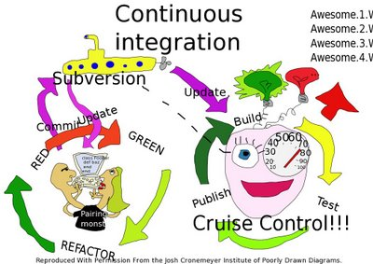

Slide 7

Unidade de Trabalho

Slide 8
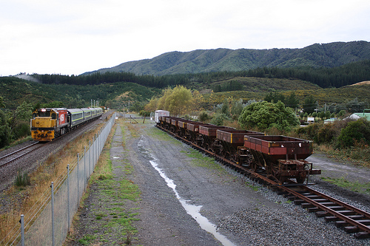
Mainline

Slide 9
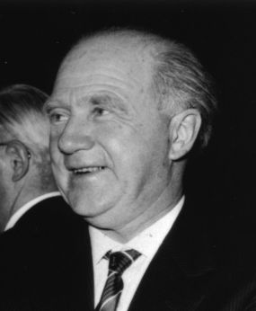
Werner Heisenberg

Slide 10

Operações Atômicas

Slide 11

Checkout Exclusivo
Notes:
PERGUNTAR

Slide 12
“
Continuous Integration is a software development practice where members of a team integrate their work frequently, usually each person integrates at least daily - leading to multiple integrations per day. Each integration is verified by an automated build (including test) to detect integration errors as quickly as possible.
Martin Fowler
(http://www.martinfowler.com/articles/continuousIntegration.html)

Slide 13




Version Control
Notes:
Falar do cliente

Slide 14

Seja um Escoteiro

Slide 15
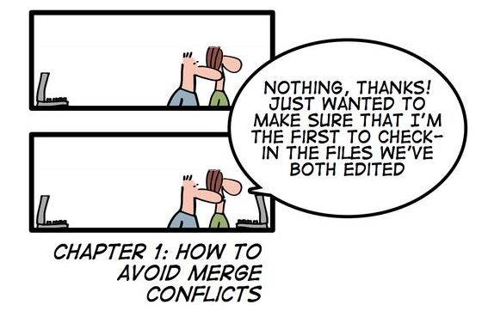

Slide 16

Build Automatizado
Notes:
NÃO É SERVIDOR AUTOMATIZADO

Slide 17
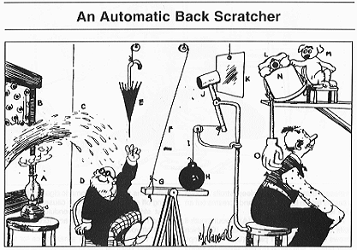

Slide 18
msbuildtasks.tigris.org
albacorebuild.net

Slide 19
“
Compilou,
0 errors, 0 warnings,
tá tudo ok.
Lincoln Júnior
Notes:
PERGUNTAR

Slide 20

“
I find your lack of tests disturbing.
Sebastian Bergmann

Slide 21

Testando o sistema antes
de mandar para o cliente

Slide 22

Sandbox
Notes:
AVANÇAR PRÓXIMO COM PIADA

Slide 23
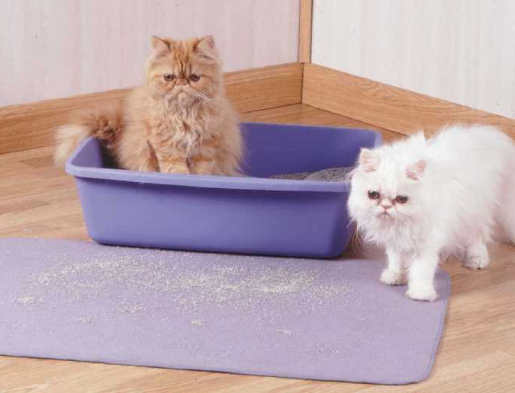
Litter Box
Notes:
PERGUNTAR (QUANTOS OBRIGADOS)

Slide 24
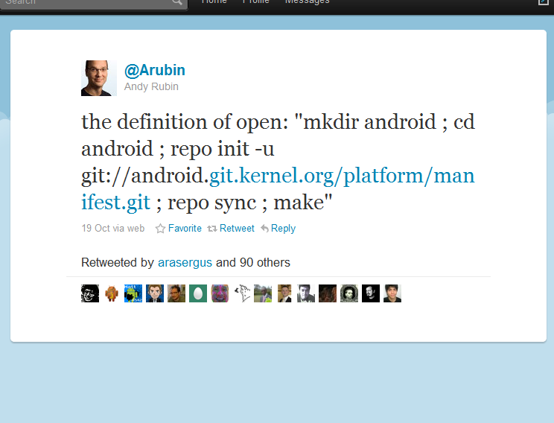

Slide 25
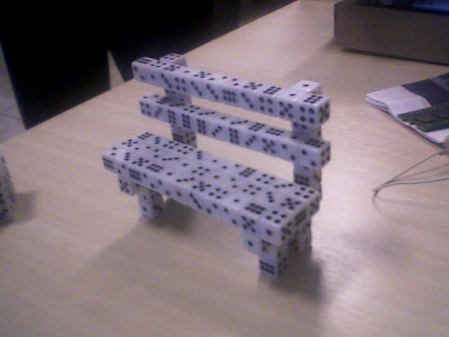
Banco de Dados

Slide 26

Backup/Restore

Slide 27

Migrations

Slide 28
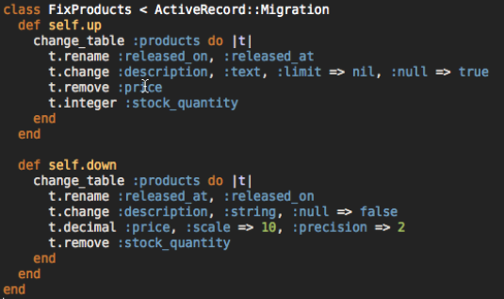
Rails Migrations

Slide 29
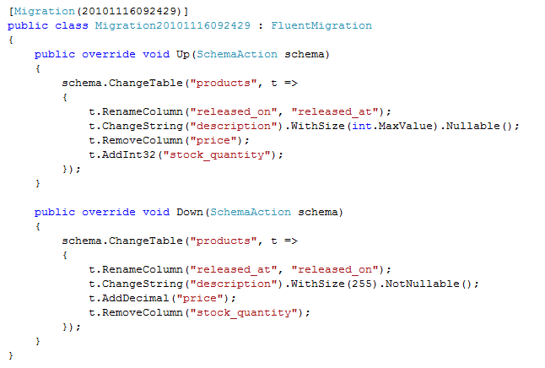
.Net Migrations

Slide 30

Integração Machine-friendly
Ok, não tão
friendly.

Slide 31
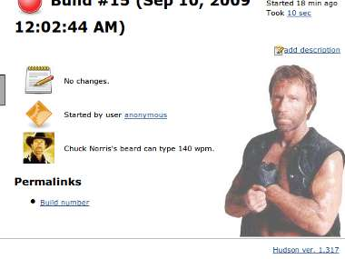
Ai sim, um servidor.

Slide 32
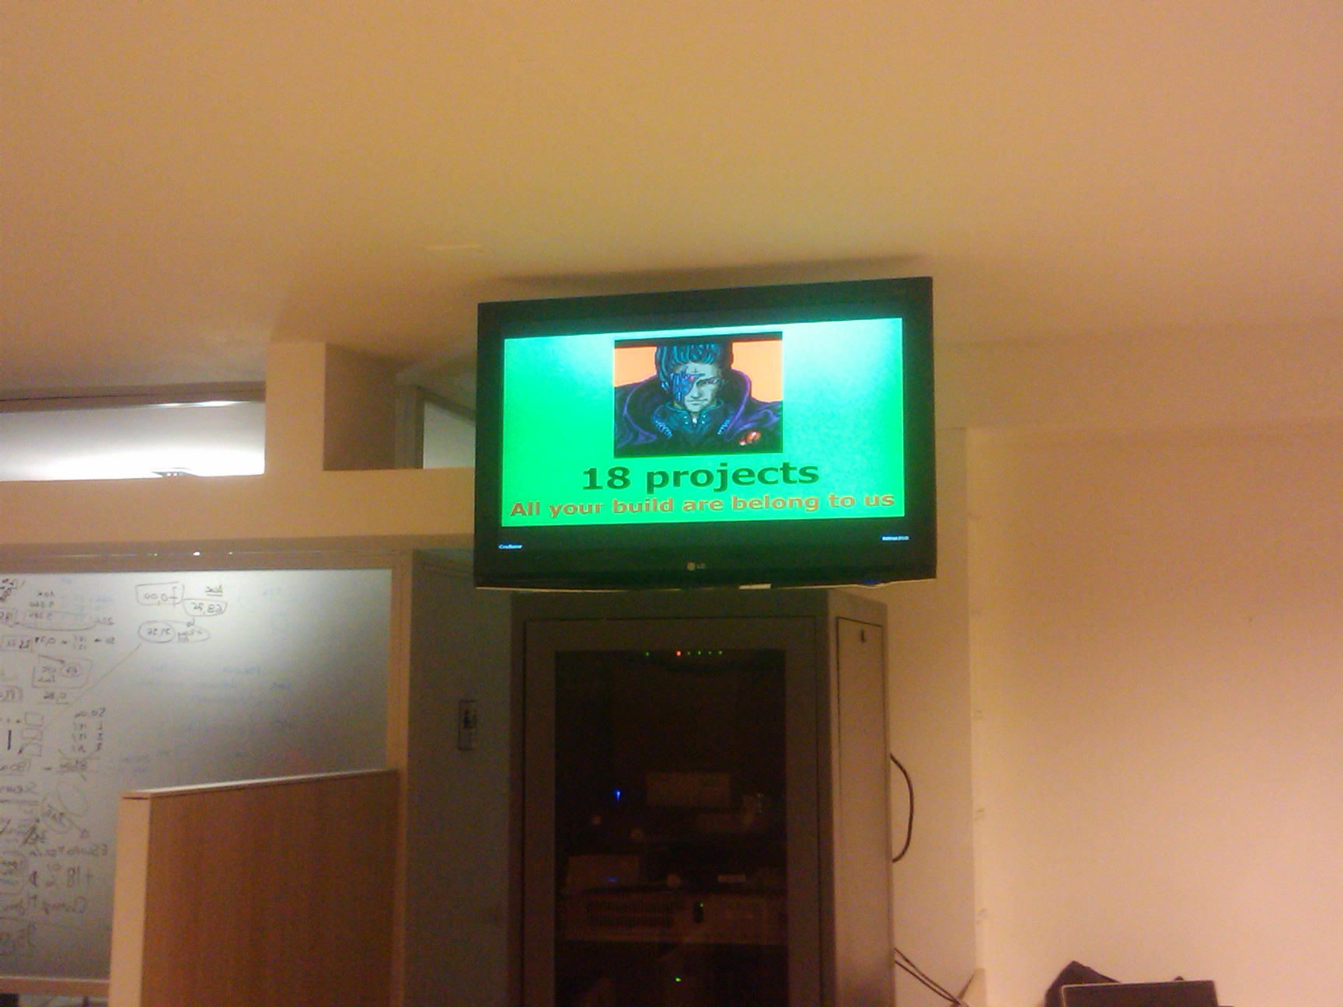
Radiators! :-D

Slide 33
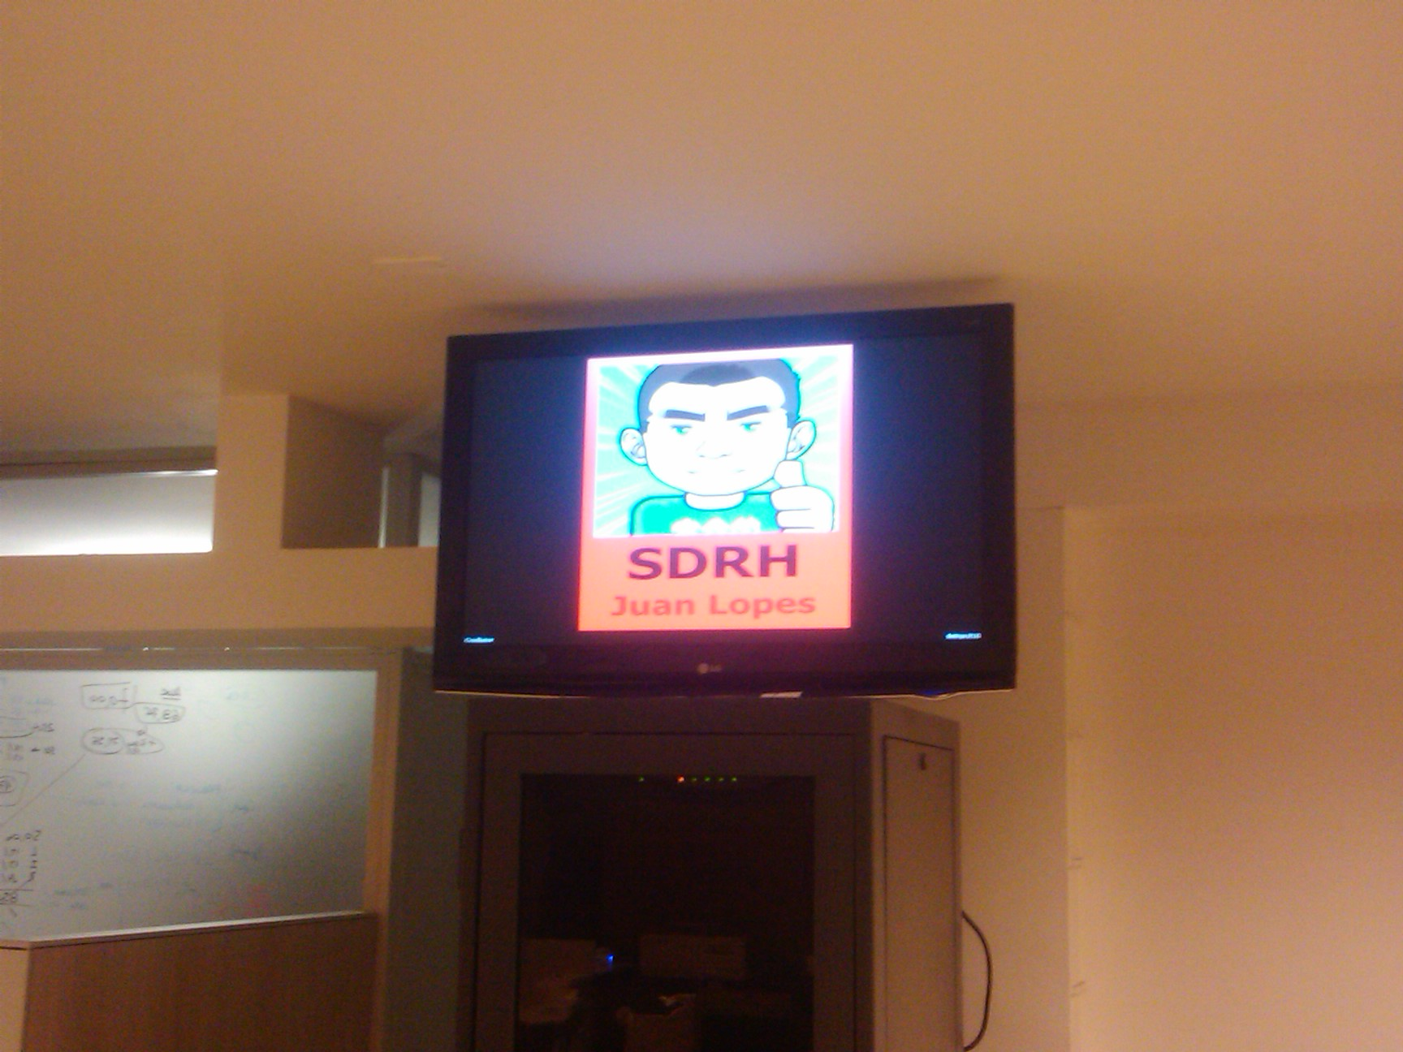
Radiators! :-(

Slide 34

Nightly Builds

Slide 35
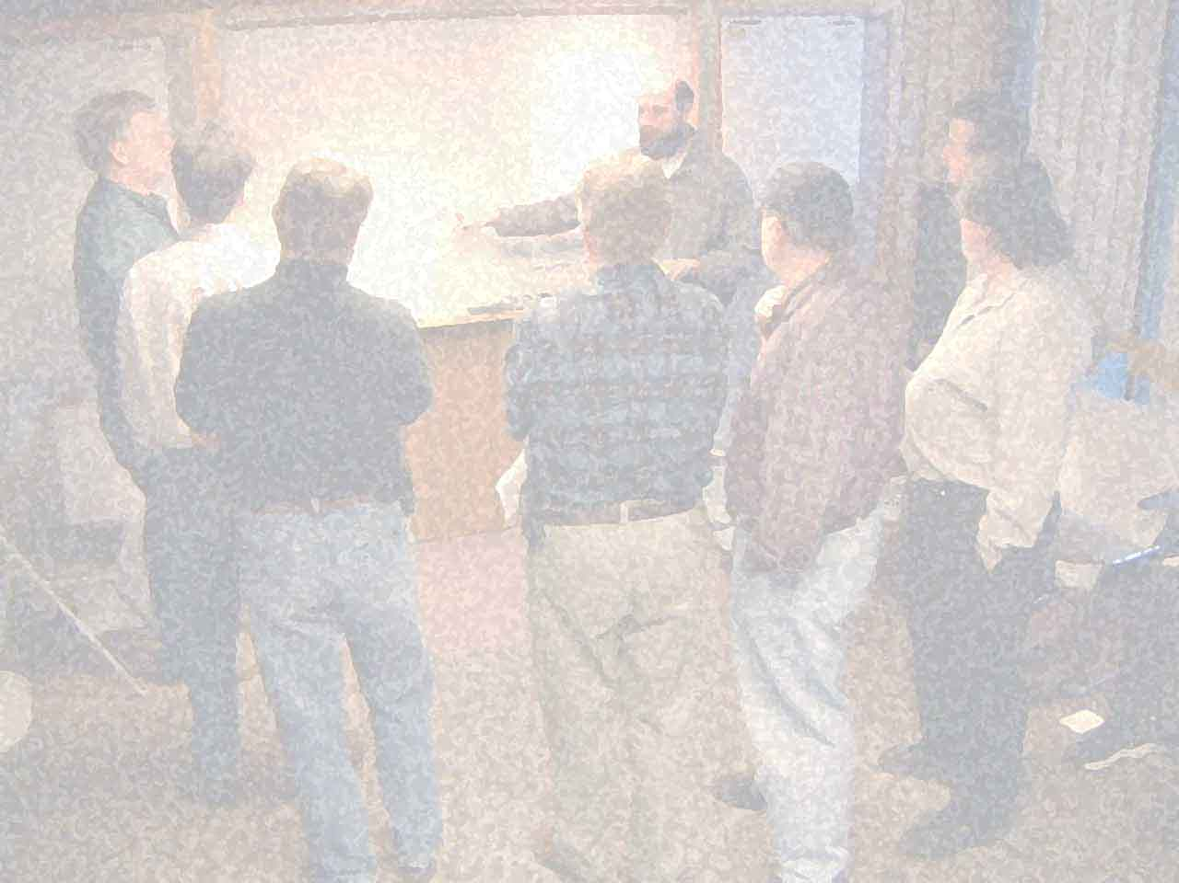
Notes:
PERGUNTAR SOBRE OS PRINCÍPIOS

Slide 36
Principles behind the Agile Manifesto
(...)
Deliver working software frequently, from a
couple of weeks to a couple of months, with a
preference to the shorter timescale.
(...)

Slide 37
couple of days

Slide 38
couple of hours!

Slide 39
“
Release Early. Release Often.
And listen to your customers.
Eric S. Raymond (who credits Linus Torvalds)

Slide 40
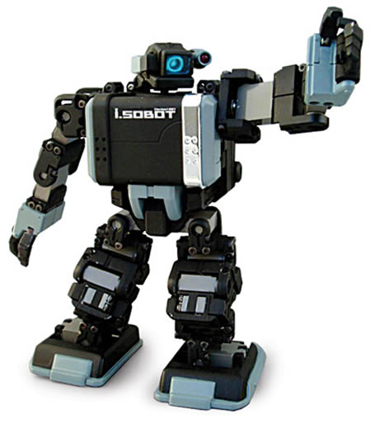
github.com/juanplopes/ci-alem-do-build
Obrigado!

